Slide 1
Database design and Applications Prof Manjunath N

Slide 2

Session 3
Topic : Logical design I
(ER /EER to RM)

Slide 3

LEARNING OUTCOME
Relational model concepts
Relational data model constraints
ER /EER to RM
REFER: T1-Chapter 5
Sections:
5.1- 5.3

Slide 4
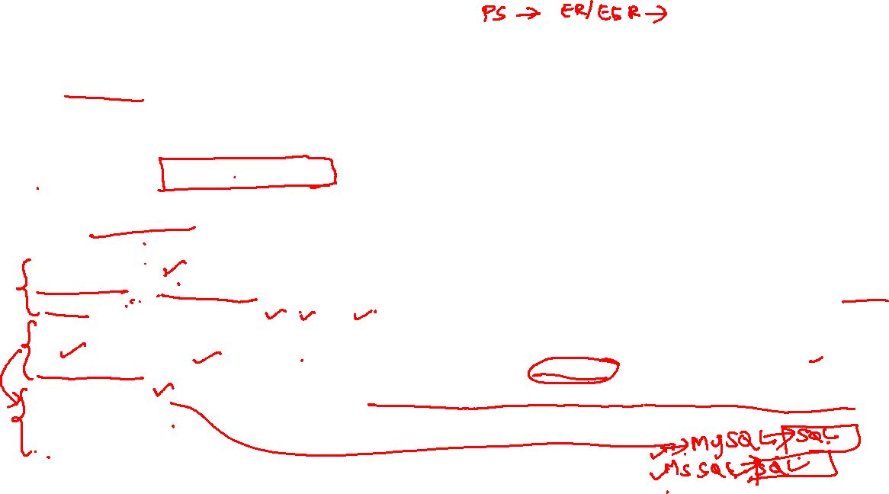
Data Model and schema
The data model emphasizes on what data is needed and how it should be organized instead of what operations will be performed on data.
The data models are used to represent the data and how it is stored in the database and to set the relationship between data items.
Data Model is like an architect's building plan, which helps to build conceptual models and set a relationship between data items. So it is an abstract model that organizes data description, data semantics, and consistency constraints of data.
There are 3 different types of data models: conceptual data models, logical data models, and physical data models, and each one has a specific purpose.
1. Conceptual Data Model: This Data Model defines WHAT the system contains. This model is typically created by Business stakeholders and Data Architects. The purpose is to organize, scope and define business concepts and rules. This is a high level data model where we use ER , EER and UML to represent the business concepts and organize data.
Logical Data Model: Defines HOW the system should be implemented regardless of the DBMS. This model is typically created by Data Architects and Business Analysts. The purpose is to developed technical map of rules and data structures. Schema or relational schema is belonging to logical data model. Schema means a logical view.
Physical Data Model: This Data Model describes HOW the system will be implemented using a specific DBMS system. This model is typically created by DBA and developers. The purpose is actual implementation of the database. While table basically stored in files belong to physical data model.

Slide 5
Relational model concepts

Slide 6
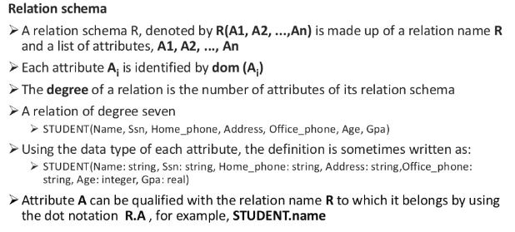
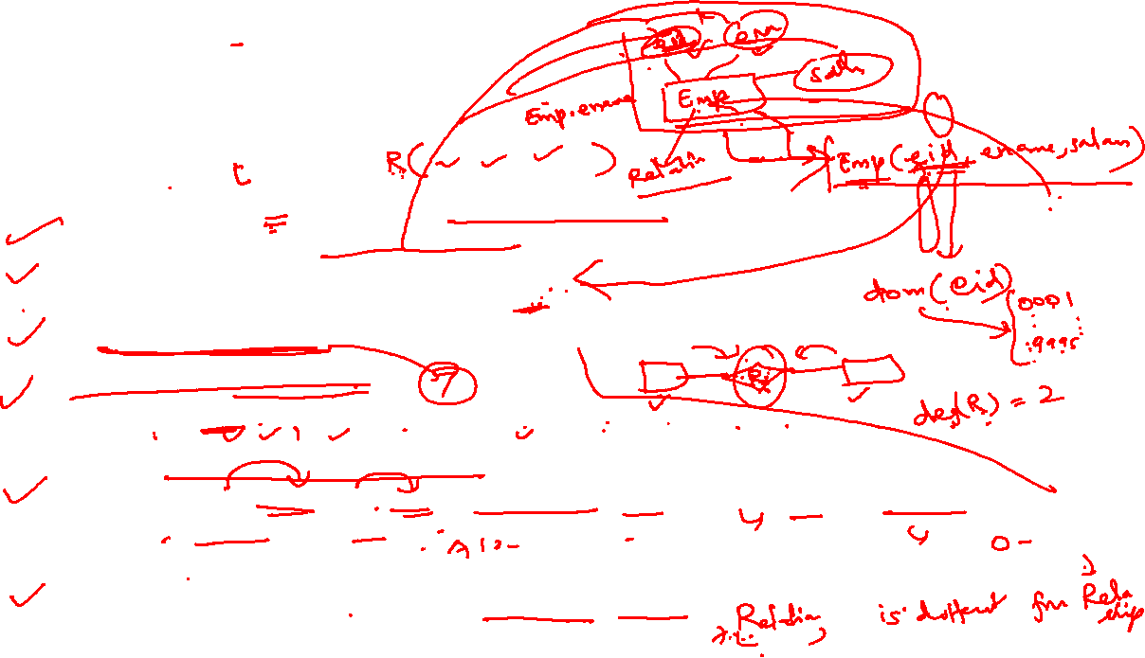
Relational Model Concepts
What is a RELATION SCHEMA?

Slide 7
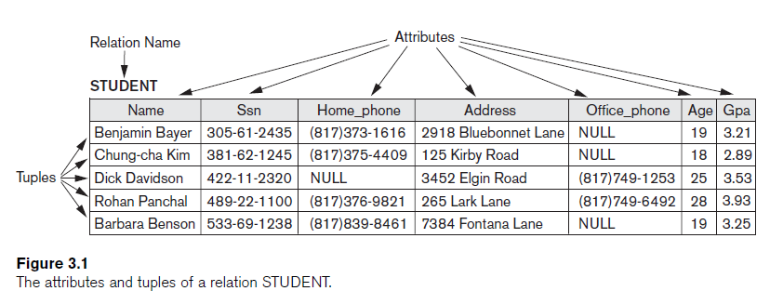
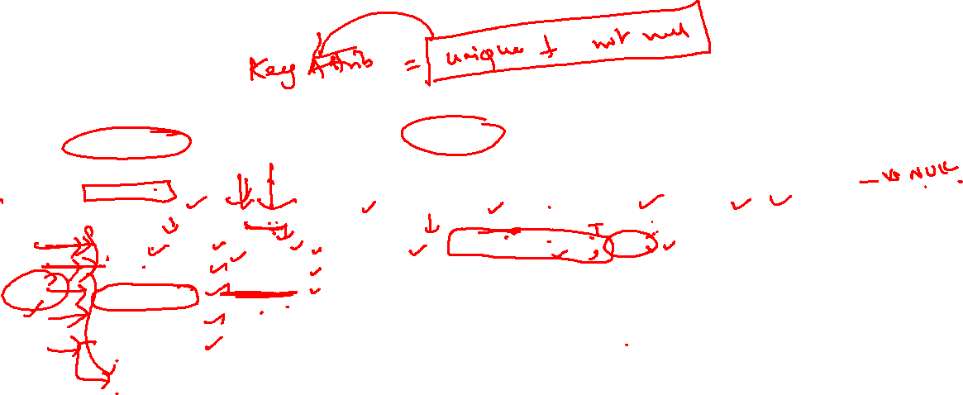

Slide 8
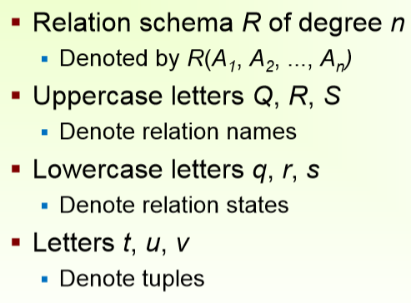

Characteristics of relations
a relation is a set – tuples are not in any order, and have no duplicates
flat relational model – values are atomic, not structures or lists
NULL (ω) – “information missing”, “not applicable”; ambiguous semantics, not a member of any domain
the order in which the attributes are listed in a table is irrelevant.
The Null value: used for don't know, not applicable or value undefined
Values of Attributes: For a relation to be in First Normal Form, each of its attribute domains must consist of atomic (neither composite nor multi-valued) values.
Notation

Slide 9
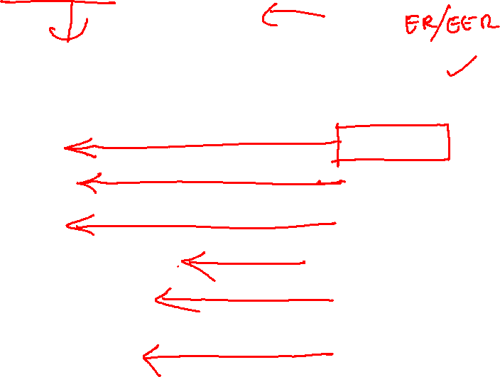
Relational Model Concepts
Informal Terms |  | Formal Terms
Table |  | Relation
Column |  | Attribute/Domain
Row |  | Tuple
Values in a column |  | Domain
Table Definition |  | Schema of a Relation
Populated Table |  | Extension

Slide 10
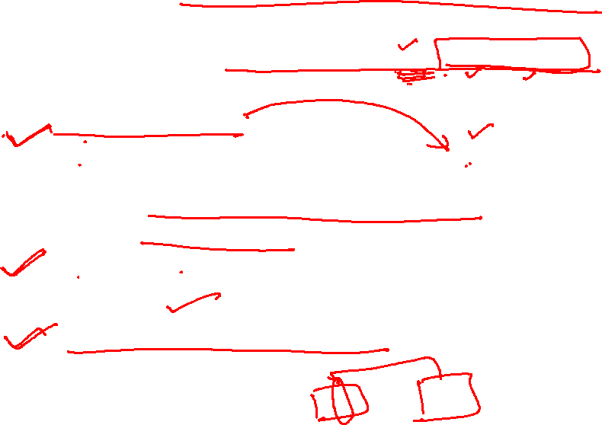
Explicit or Schema-based constraints
Constraints are conditions that must hold on all valid relation instances.
There are three main types of constraints:
1.Key constraints
Each attribute value must be either null (which is really a non-value) or drawn from the domain of that attribute.
for any two distinct tuples t1 and t2 in a relation state r of R, we have the constraint that: t1[SK] ≠ t2[SK]
2. Entity integrity constraints The primary key attributes PK of each relation schema cannot have null values in any tuple.
3. Referential integrity constraints tuple in one relation is related to tuple in another relation.

Slide 11
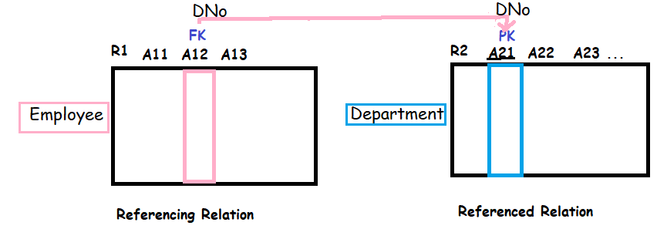
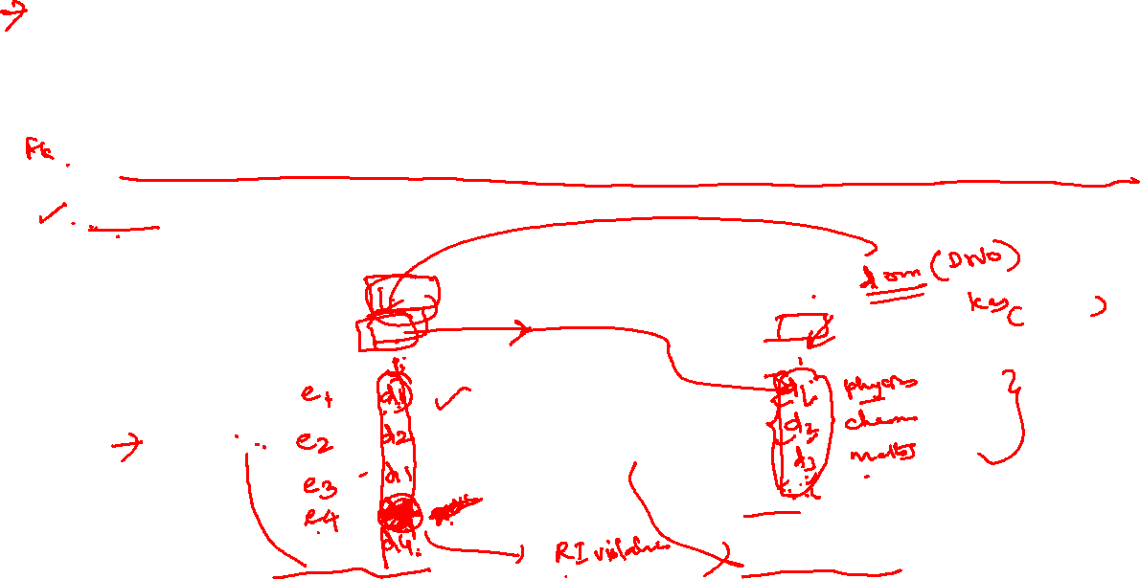
Referential Integrity Constraint
Statement of the constraint
The value in the foreign key column (or columns) FK of the the referencing relation R₁ can be either:
(1) a value of an existing primary key value of the corresponding primary key PK in the referenced relation R_{2,}, or..
(2) a null.
In case (2), the FK in R₁ should not be a part of its own primary key.

Slide 12
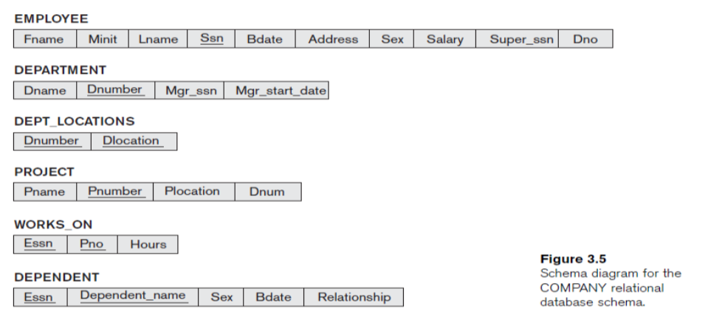
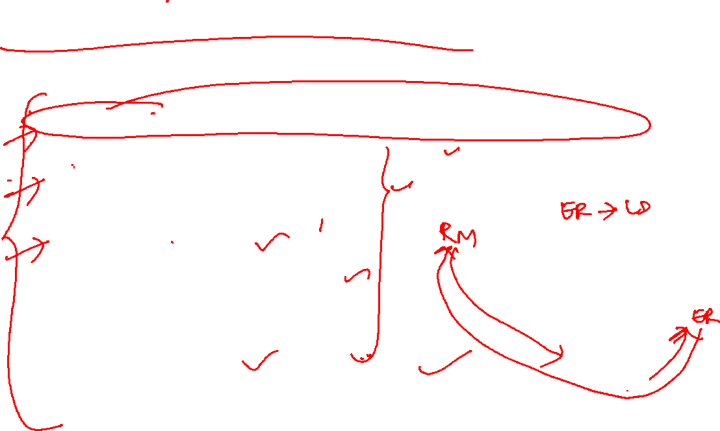
Relational DB and Relational DB Schemas

Slide 13
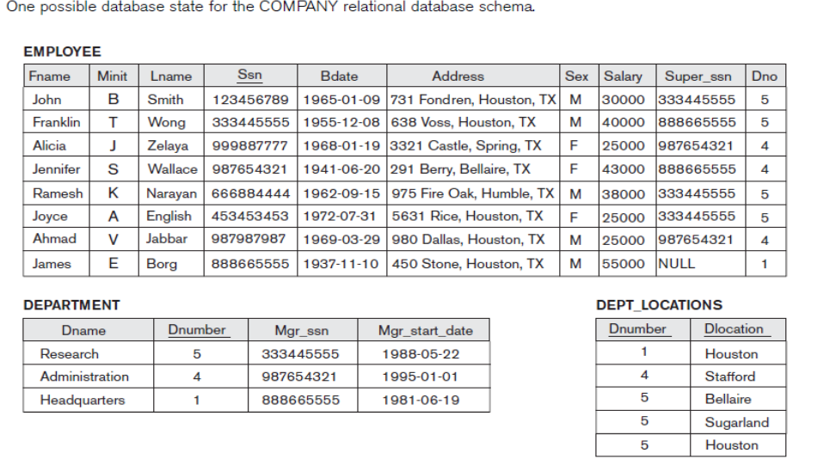

Relational DB and Relational DB Schemas

Slide 14
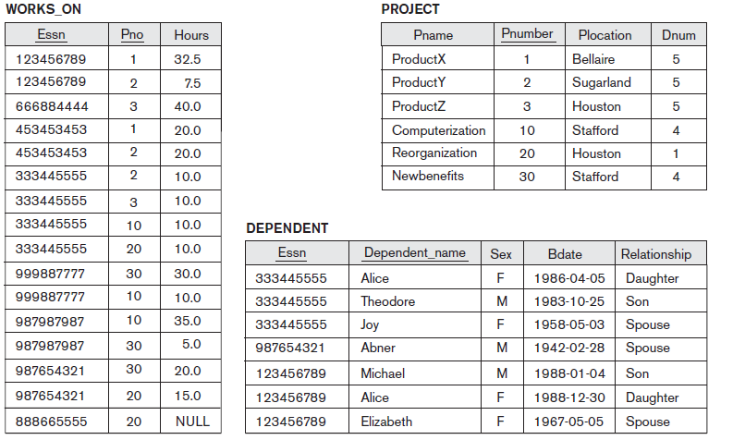

One possible database state for the COMPANY relational database schema.

Slide 15
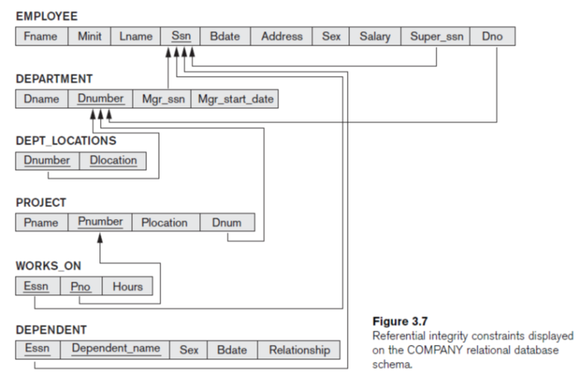

Relations together with a set of integrity constraints.

Slide 16
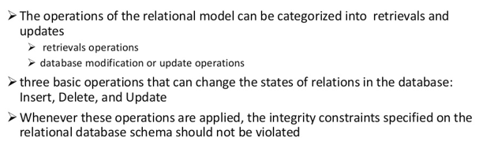
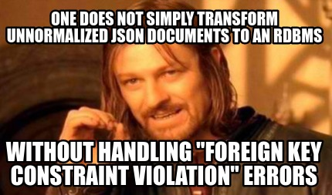

Operations and Constraint violation
We now see how violations happens
INSERT a tuple.
DELETE a tuple.
MODIFY/Update a tuple.

Slide 17
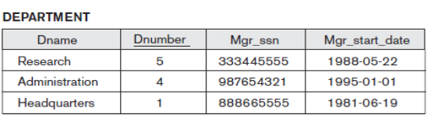
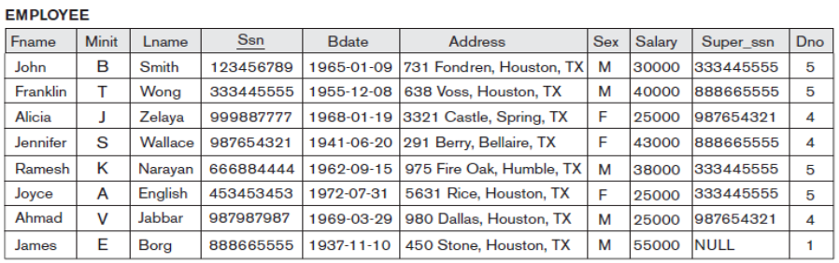
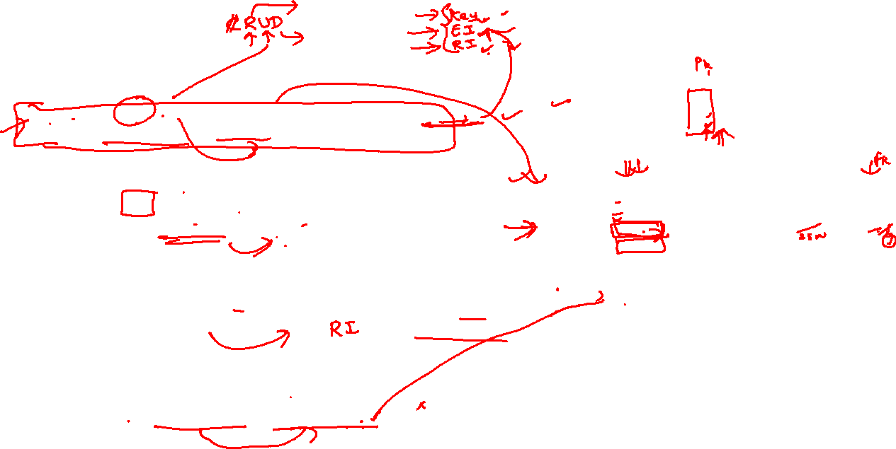
Update Operations on Relations and violations
■ Operation:
Update the salary of the EMPLOYEE tuple with Ssn = ‘999887777’ to 28000.
■ Operation:
Update the Dno of the EMPLOYEE tuple with Ssn = ‘999887777’ to 1.
■ Operation:
Update the Dno of the EMPLOYEE tuple with Ssn = ‘999887777’ to 7.
■ Operation:
Update the Ssn of the EMPLOYEE tuple with Ssn = ‘999887777’ to ‘987654321’.
Result: Acceptable.
Result: Acceptable.
Result: Unacceptable, because it violates referential integrity.
Result:: Unacceptable, because it violates primary key constraint by repeating a value that already exists as a primary key in another tuple; it violates referential integrity constraints because there are other relations that refer to the existing value of Ssn

Slide 18
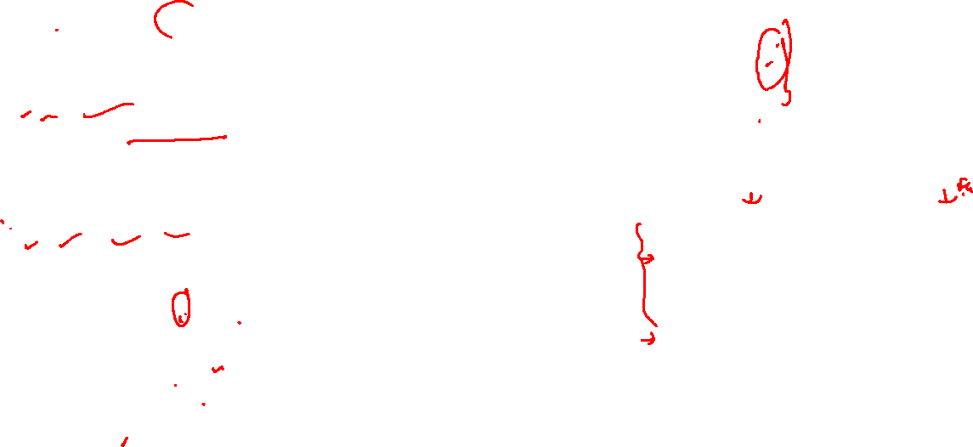
Insert operation and handle violation
■ Operation:
Insert <‘Cecilia’, ‘F’, ‘Kolonsky’, NULL, ‘1960-04-05’, ‘6357 Windy Lane, Katy,
TX’, F, 28000, NULL, 4> into EMPLOYEE.
Result: This insertion violates the entity integrity constraint (NULL for the
primary key Ssn), so it is rejected.
■ Operation:
Insert <‘Alicia’, ‘J’, ‘Zelaya’, ‘999887777’, ‘1960-04-05’, ‘6357 Windy Lane, Katy,
TX’, F, 28000, ‘987654321’, 4> into EMPLOYEE.
Result: This insertion violates the key constraint because another tuple with the same Ssn value already exists in the EMPLOYEE relation, and so it is
rejected.
■ Operation:
Insert <‘Cecilia’, ‘F’, ‘Kolonsky’, ‘677678989’, ‘1960-04-05’, ‘6357 Windswept,
Katy, TX’, F, 28000, ‘987654321’, 7> into EMPLOYEE.
Result: This insertion violates the referential integrity constraint specified on Dno in EMPLOYEE because no corresponding referenced tuple exists in
DEPARTMENT with Dnumber = 7
■ Operation:
Insert <‘Cecilia’, ‘F’, ‘Kolonsky’, ‘677678989’, ‘1960-04-05’, ‘6357 Windy Lane,
Katy, TX’, F, 28000, NULL, 4> into EMPLOYEE.
Result: This insertion satisfies all constraints, so it is acceptable

Slide 19
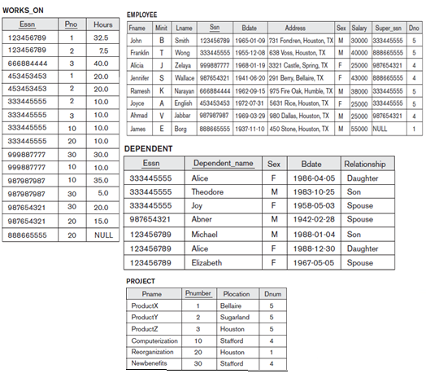
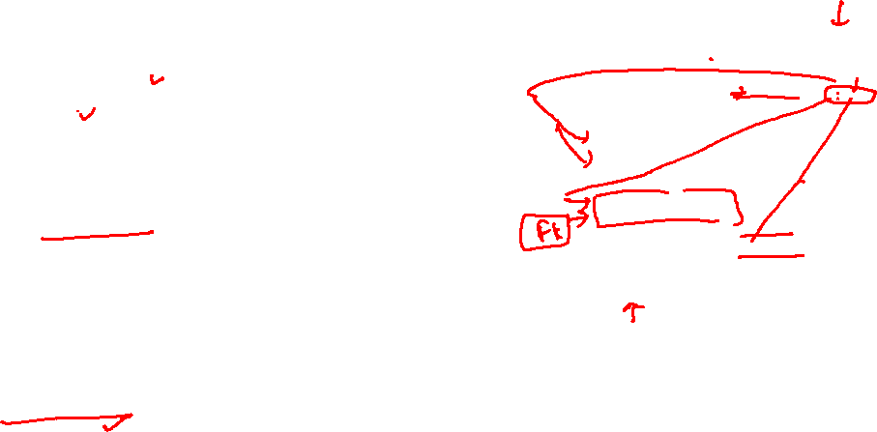
Delete operations and constraint violations
■ Operation:
Delete the WORKS_ON tuple with Essn = ‘999887777’ and Pno = 10.
Result: This deletion is acceptable and deletes exactly one tuple.
■ Operation:
Delete the EMPLOYEE tuple with Ssn = ‘999887777’.
Result: This deletion is not acceptable, because there are tuples in WORKS_ON that refer to this tuple. Hence, if the tuple in
EMPLOYEE is deleted, referential integrity violations will result.
■ Operation:
Delete the EMPLOYEE tuple with Ssn = ‘333445555’.
Result: This deletion will result in even worse referential integrity violations, because the tuple involved is referenced by tuples from the EMPLOYEE, DEPARTMENT, WORKS_ON, and DEPENDENT relations

Slide 20
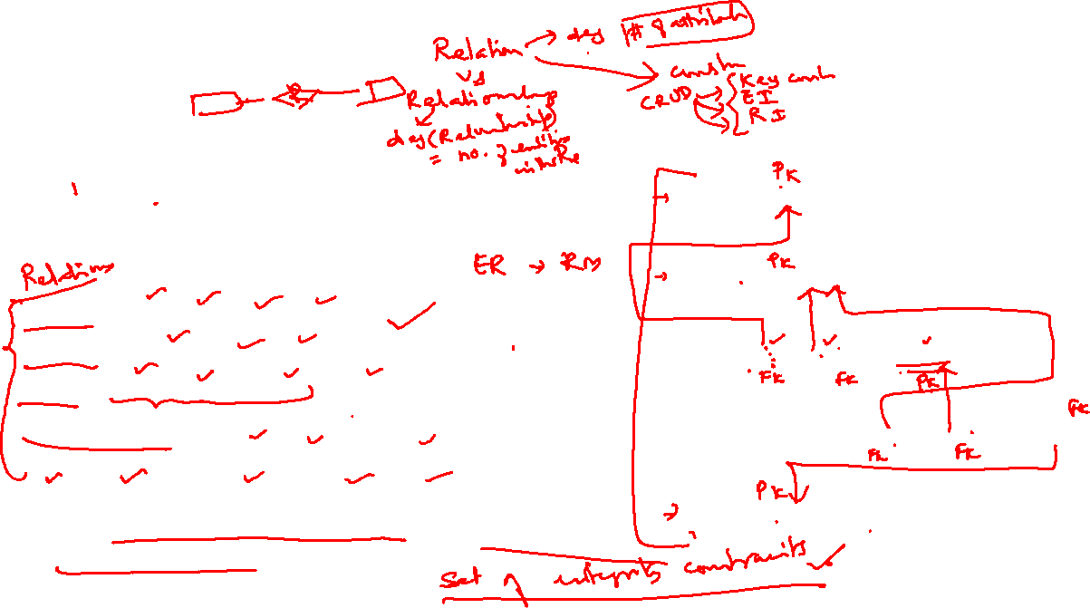
In-Class Exercise
Consider the following relations for a database that keeps track of student enrollment in courses and the books adopted for each course:
STUDENT(SSN, Name, Major, Bdate)
COURSE(Course#, Cname, Dept)
ENROLL(SSN, Course#, Quarter, Grade)
BOOK_ADOPTION(Course#, Quarter, Book_ISBN)
TEXT(Book_ISBN, Book_Title, Publisher, Author)
Draw a relational schema diagram specifying the foreign keys for this schema.
STUDENT(SSN, Name, Major, Bdate)
COURSE(Course#, Cname, Dept)
ENROLL(SSN, Course#, Quarter, Grade)
BOOK_ADOPTION(Course#, Quarter, Book_ISBN)
TEXT(Book_ISBN, Book_Title, Publisher, Author)

Slide 21

LEARNING OUTCOME
Mapping ER Constructs to relations
Mapping Class hierarchies
REFER: T1-Chapter 5
Sections:
5.1- 5.3

Slide 22
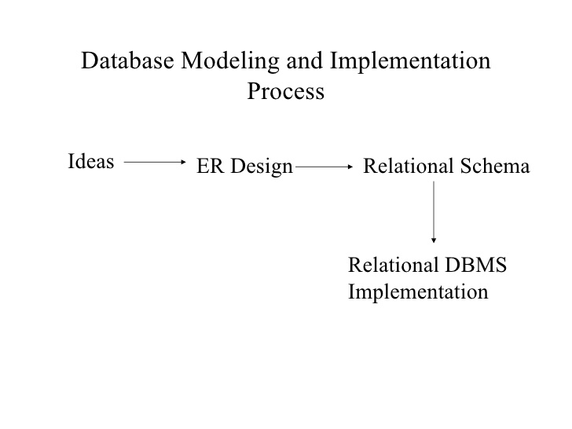
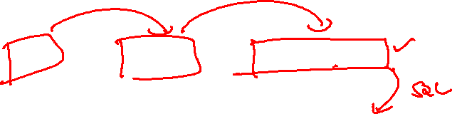
Database Modelling and Implementation Process
(Problem statement)

Slide 23
Mapping ER Constructs to relations

Slide 24
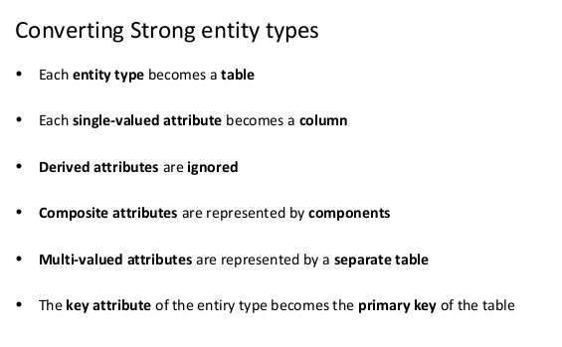
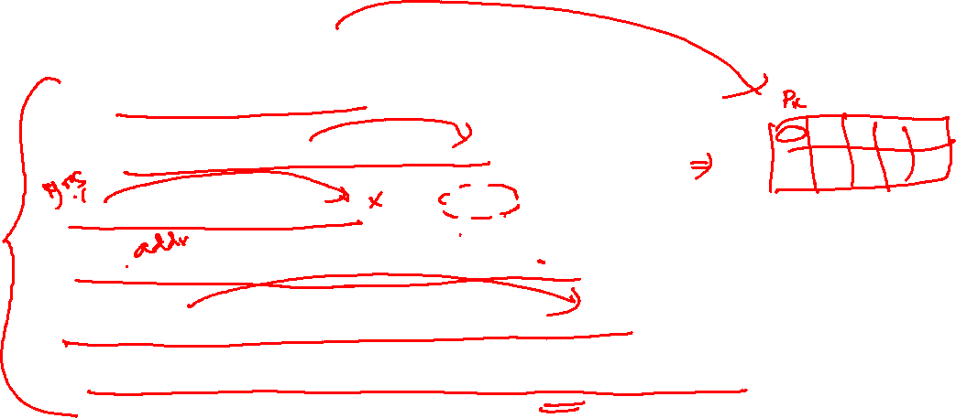
ER Constructs to relations

Slide 25
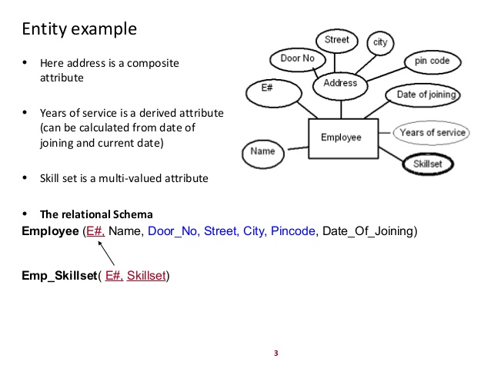
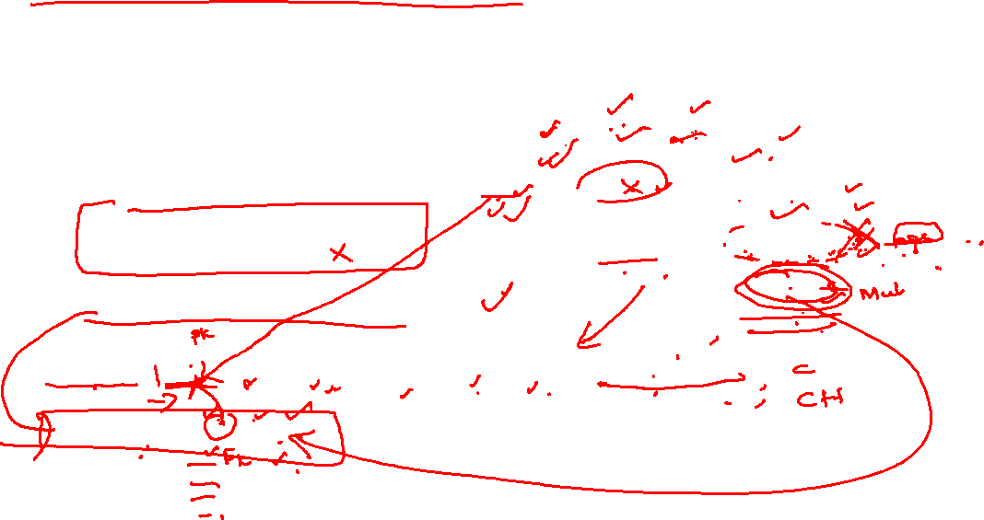
ER Constructs to relations

Slide 26
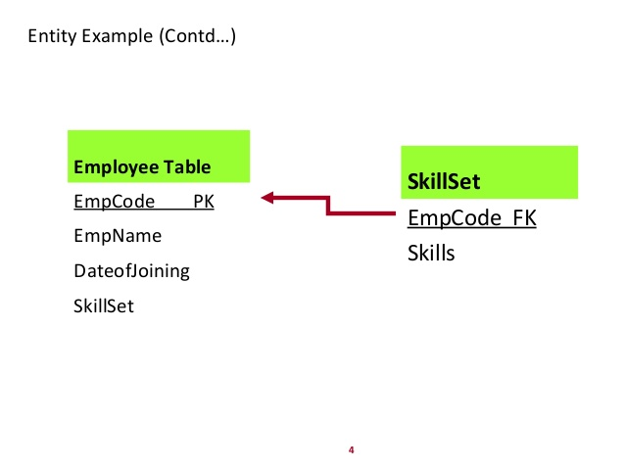

ER Constructs to relations

Slide 27
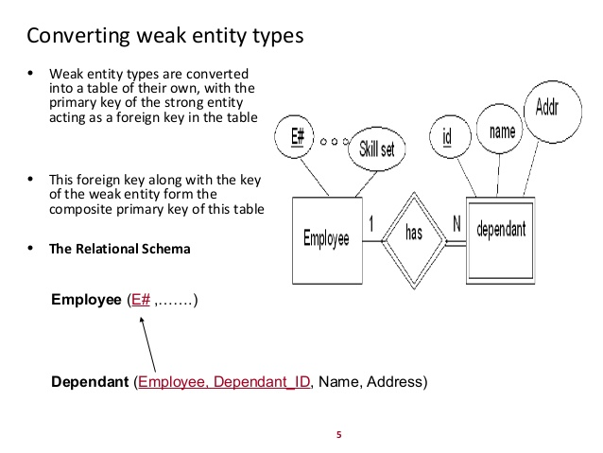


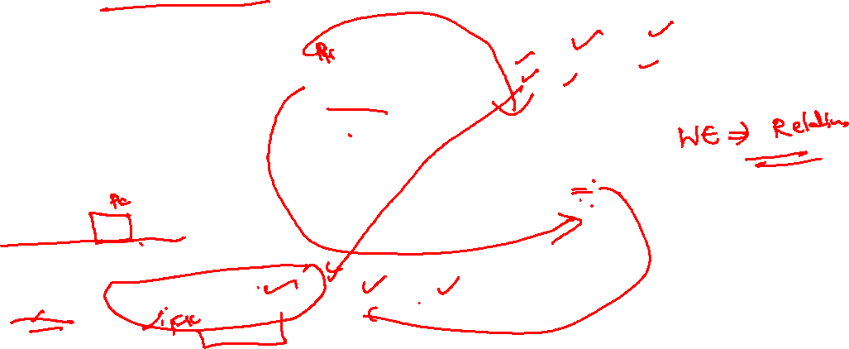
ER Constructs to relations

Slide 28
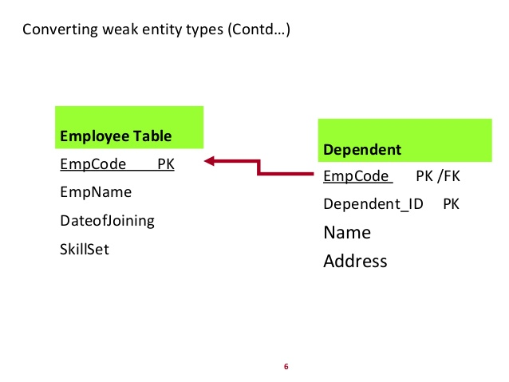
ER Constructs to relations

Slide 29
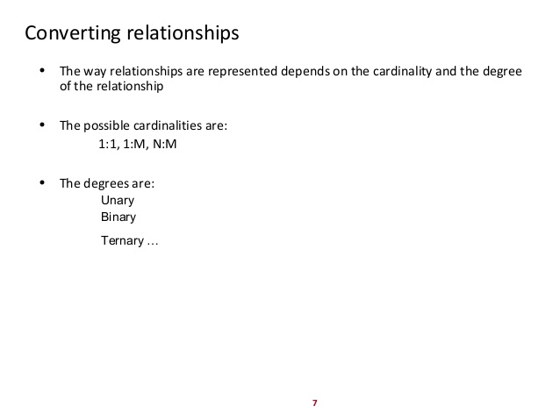

ER Constructs to relations

Slide 30
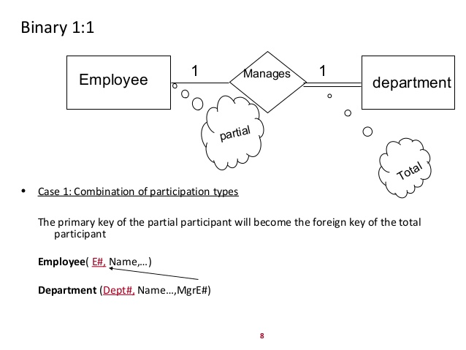
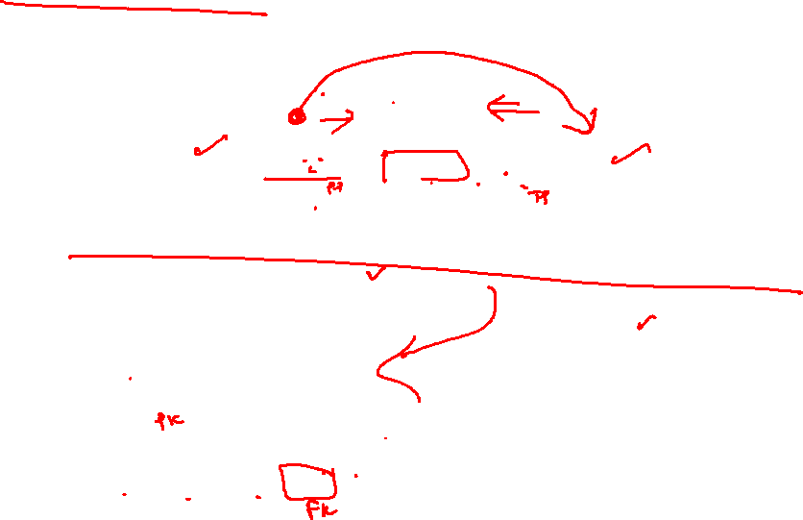

ER Constructs to relations

Slide 31
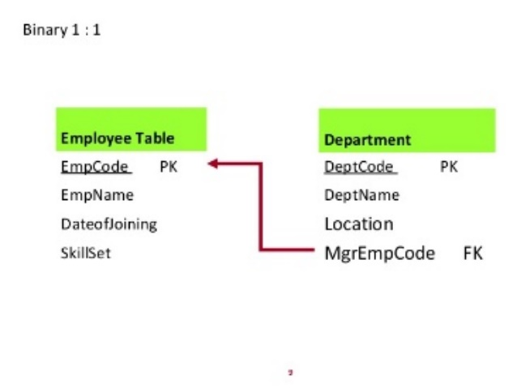
ER Constructs to relations

Slide 32
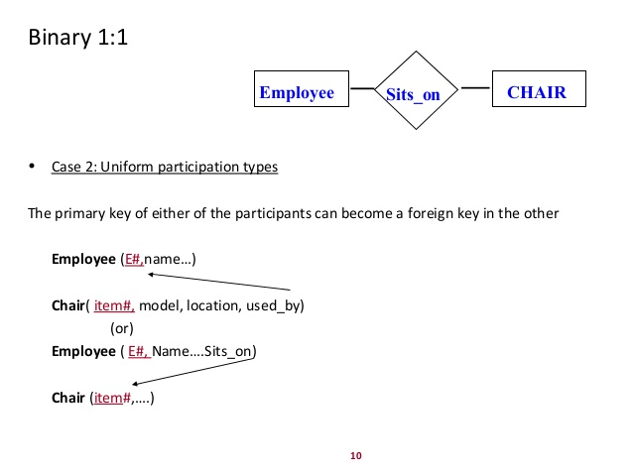
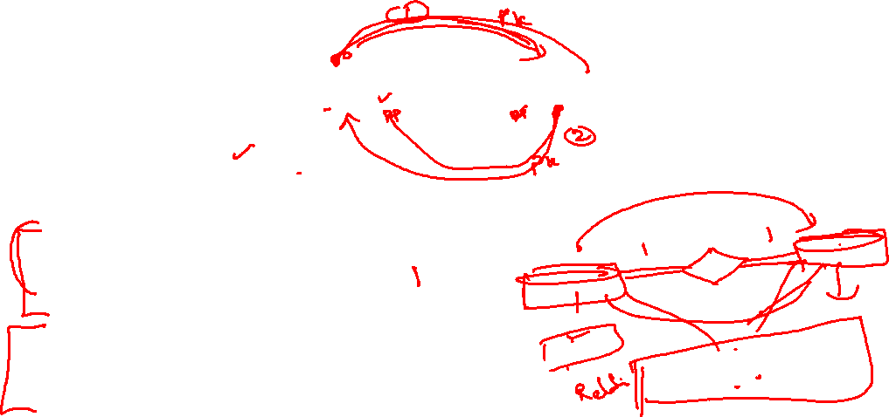
ER Constructs to relations

Slide 33
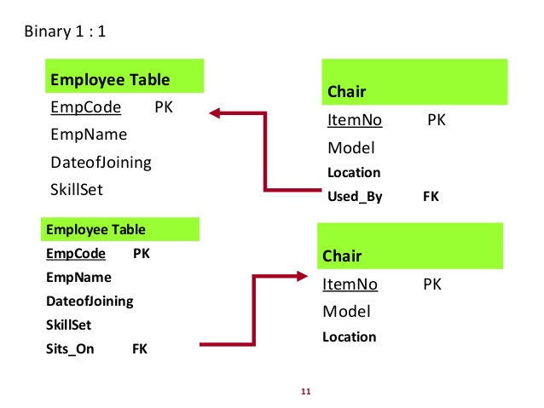
ER Constructs to relations

Slide 34
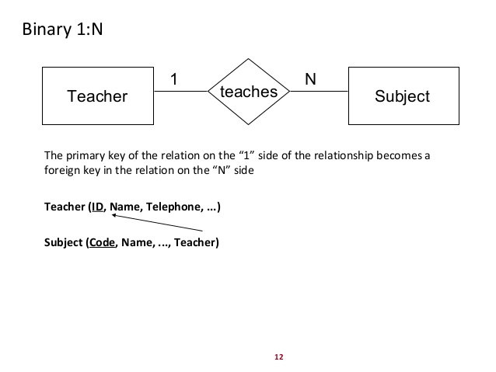
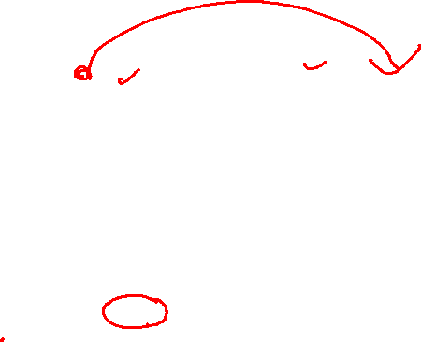
ER Constructs to relations

Slide 35
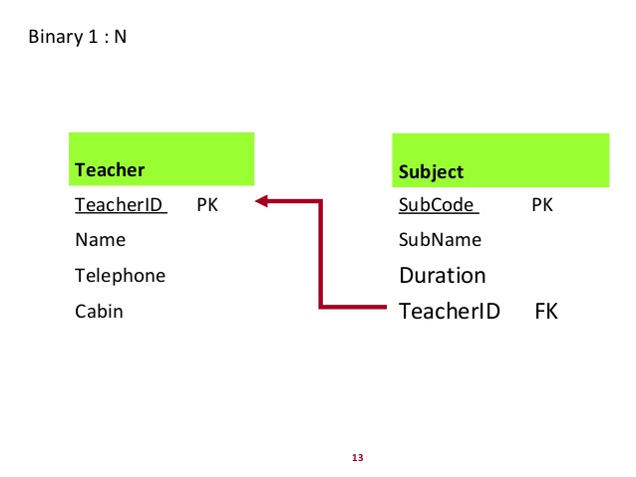
ER Constructs to relations

Slide 36
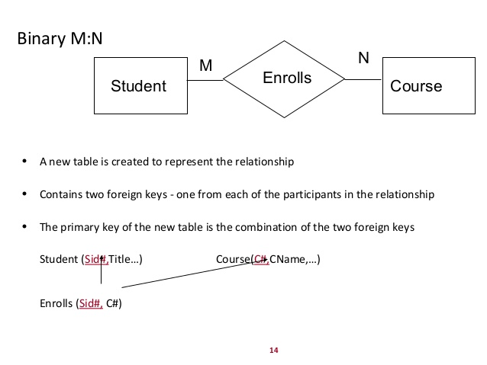
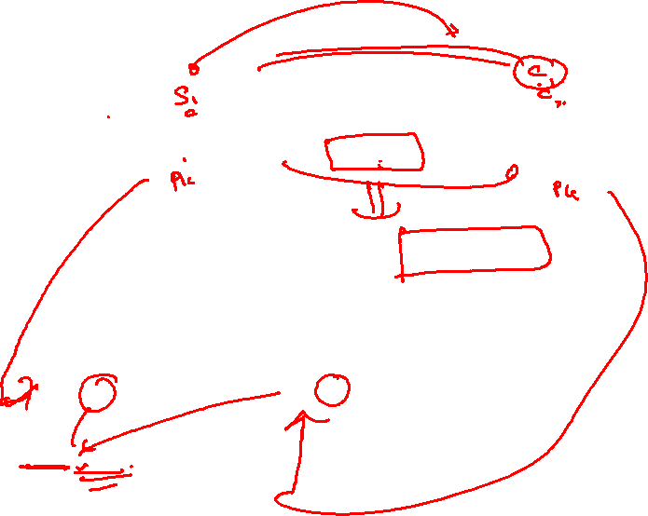
ER Constructs to relations

Slide 37
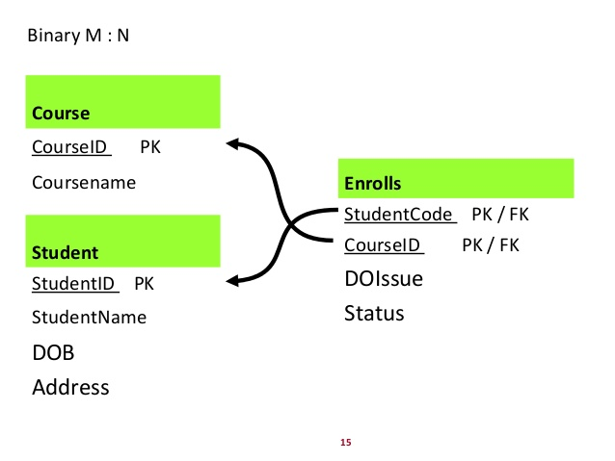
ER Constructs to relations

Slide 38
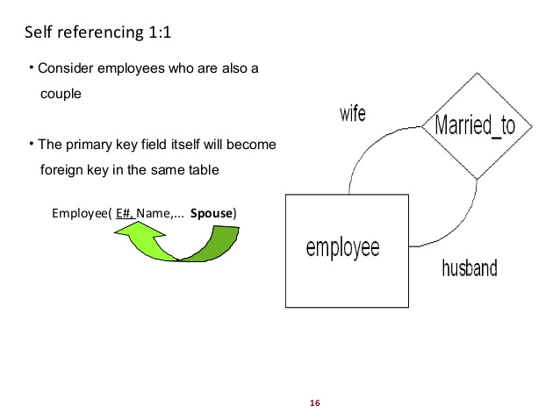

ER Constructs to relations

Slide 39
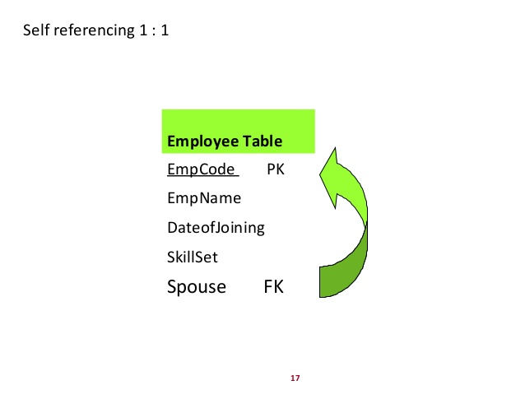
ER Constructs to relations

Slide 40
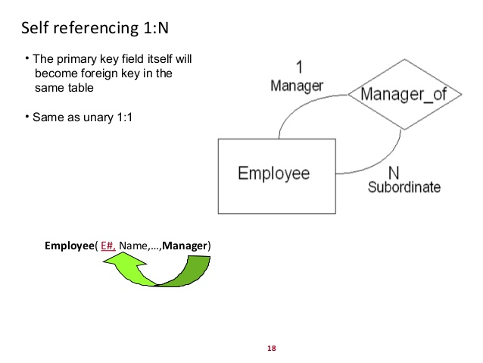

ER Constructs to relations

Slide 41

ER Constructs to relations

Slide 42


ER Constructs to relations

Slide 43

ER Constructs to relations

Slide 44


ER Constructs to relations

Slide 45

ER Constructs to relations

Slide 46

ER Constructs to relations
ER-to-Relational Mapping Algorithm
Step 1: Mapping of Regular Entity Types
Step 2: Mapping of Weak Entity Types
Step 3: Mapping of Binary 1:1 Relation Types
Step 4: Mapping of Binary 1:N Relationship Types.
Step 5: Mapping of Binary M:N Relationship Types.
Step 6: Mapping of Multivalued attributes.
Step 7: Mapping of N-ary Relationship Types.
Mapping EER Model Constructs to Relations
Step 8: Options for Mapping Specialization or Generalization.
Step 9: Mapping of Union Types (Categories).

Slide 47
ER-to-Relational Mapping Steps
Step 7: Mapping of N-ary Relationship Types. (Non-binary relationships)
For each n-ary relationship type R, where n > 2, create a new relation S to represent R.
Include as foreign key attributes in S the primary keys of the relations that represent the participating entity types.
Also include any simple attributes of the n-ary relationship type (or simple components of composite attributes) as attributes of S.
Example:
The relationship type SUPPY in the ER on the next slide. This can be mapped to the relation SUPPLY shown in the relational schema, whose primary key is the combination of the three foreign keys {SNAME, PARTNO, PROJNAME}

Slide 48


ER-to-Relational Mapping Steps
FIGURE 4.11 Ternary relationship types. (a) The SUPPLY relationship.

Slide 49



ER-to-Relational Mapping Steps
FIGURE 7.3 Mapping the n-ary relationship type SUPPLY from Figure 4.11a.

Slide 50


ER-to-Relational Mapping Steps
Notes:
https://core.ac.uk/download/pdf/81570774.pdf

Slide 51


ER-to-Relational Mapping Steps

Slide 52
ER to RM tutorials

Slide 53



Problem 1

Slide 54


solution 1

Slide 55



Alternate Solution

Slide 56



Problem 2:

Slide 57

Solution:

Slide 58



Problem 3:

Slide 59


Solution :

Slide 60



TEXTBOOK Problem : COMPANY DB

Slide 61


COMPANY : ER

Slide 62


Solution:

Slide 63

EER-to-Relational Mapping Steps

Slide 64
EER-to-Relational Mapping Steps
Step8: Options for Mapping Specialization or Generalization.
Option 8A: Multiple relations, Super class and subclasses.
Create a relation for the super class, including the super class attributes.
Create a relation for each subclass, which includes the primary key of the super class (which acts as the foreign key) and the attributes of the subclass specialization.
This works for any specialization (partial, total, disjoint, overlapping)
Option 8B: Multiple relations, Subclass relations only
Create a relation for each subclass, with the attributes of both the super class and the attributes of the subclass.
This only works for total specializations, meaning that every entity in the super class must belong to at least one subclass. Otherwise members of the super class that don’t belong to a subclass will not be represented.

Slide 65


EER-to-Relational Mapping Steps
Multiple relations, Super class and subclasses.
FIGURE 7.4 – Using Option 8A
Create a relation for the super class, including the super class attributes.
Create a relation for each subclass, which includes the primary key of the super class (which acts as the foreign key) and the attributes of the subclass specialization.
This works for any specialization (partial, total, disjoint, overlapping)

Slide 66


EER-to-Relational Mapping Steps
Tonnage
Multiple relations, Subclass relations only
FIGURE 7.4 – Using Option 8B
Create a relation for each subclass, with the attributes of both the super class and the attributes of the subclass.
This only works for total specializations, meaning that every entity in the super class must belong to at least one subclass. Otherwise members of the super class that don’t belong to a subclass will not be represented.

Slide 67
EER-to-Relational Mapping Steps
Option 8C: Single relation with one type attribute.
Create a single relation, with all the attributes of the super class and all the attributes of a subclass.
Include a ‘Type’ attribute, which is the discriminating attribute which indicates which subclass the row belongs to.
This only works if the specialization is disjoint, meaning the super class entity cannot be a member of more than one subclass.
Option 8D: Single relation with multiple type attributes.
Create a single relation with all the attributes of the super class and all the attributes of the subclass.
Include a Boolean “Type” attribute for each subclass, which indicates whether the row belongs to that subclass.
This works with overlapping specializations, to indicate if the super class entity belongs to more than one subclass.

Slide 68

EER-to-Relational Mapping Steps
EngType
Single relation with one type attribute.
Create a single relation, with all the attributes of the super class and all the attributes of a subclass.
Include a ‘Type’ attribute, which is the discriminating attribute which indicates which subclass the row belongs to.
This only works if the specialization is disjoint, meaning the super class entity cannot be a member of more than one subclass.

Slide 69

EER-to-Relational Mapping Steps
Single relation with multiple type attributes
O
Create a single relation with all the attributes of the super class and all the attributes of the subclass.
Include a Boolean “Type” attribute for each subclass, which indicates whether the row belongs to that subclass.
This works with overlapping specializations, to indicate if the super class entity belongs to more than one subclass.

Slide 70


EER-to-Relational Mapping Steps
Step 9: Mapping of Union Types (Categories).
For mapping a category whose defining super classes have different keys, you can specify a new key attribute, called a surrogate key, when creating a relation to correspond to the category.
Then create a relation for each category, which includes the attributes of the category, and the surrogate key, which acts as the foreign key.

Slide 71


EER-to-Relational Mapping Steps
FIGURE 4.8 Two categories (union types): OWNER and REGISTERED_VEHICLE

Slide 72

EER-to-Relational Mapping Steps

Slide 73


EER-to-Relational Mapping Steps
We can apply any of the options discussed to a shared subclass, subject to the restrictions discussed in step 8 of the mapping algorithm. In Figure 9.6, options 8C and 8D are used for the shared subclass STUDENT_ASSISTANT. Option 8C is used in the EMPLOYEE relation (Employee_type attribute) and option 8D is used in the STUDENT relation (Student_assist_flag attribute).

Slide 74

EER-to-Relational Mapping Steps

Slide 75
EER to RM tutorials

Slide 76


Problem 4:

Slide 77

Solution :

Slide 78


Problem 5:

Slide 79

Solution 1:

Slide 80


Solution 2 :Multiple relations ,super and sub classes 8A

Slide 81

Problem 6:

Slide 82

Solution:

Slide 83
Solution

Slide 84
THANKS

